Slide 1
Deep learning یادگیری عمیق
دکتر علی ملائی

Slide 2
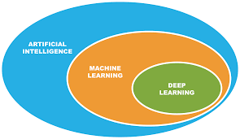
یادگیری عمیق زیرمجموعه یادگیری ماشین

Slide 3
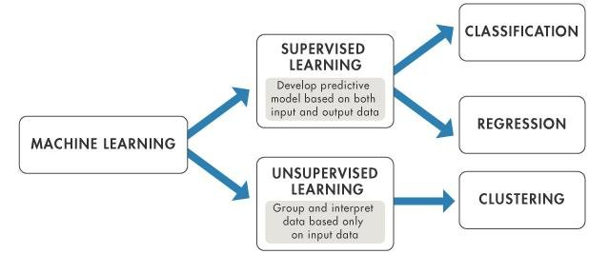
دسته بندی الگوریتم های یادگیری ماشین

Slide 4
پای ترچ
PyTorch is the autograd package, which provides automatic derivative calculations for all operations on tensors.

Slide 5
یادگیری عمیق و استخراج ویژگی
در یادگیری عمیق ویژگی ها برای یادگیری به صورت اتوماتیک استخراج می شود
در شبکه های عصبی ساده مانند MLP ویژگی ها از داده خام باید توسط فرد خبره آماده سازی شود.

Slide 6

مروری بر برخی مکانیزم های استخراج ویژگی در تصویر
https://aishack.in/tutorials/image-convolution-examples/

Slide 7

مروری بر برخی مکانیزم های استخراج ویژگی در تصویر
https://aishack.in/tutorials/image-convolution-examples/

Slide 8
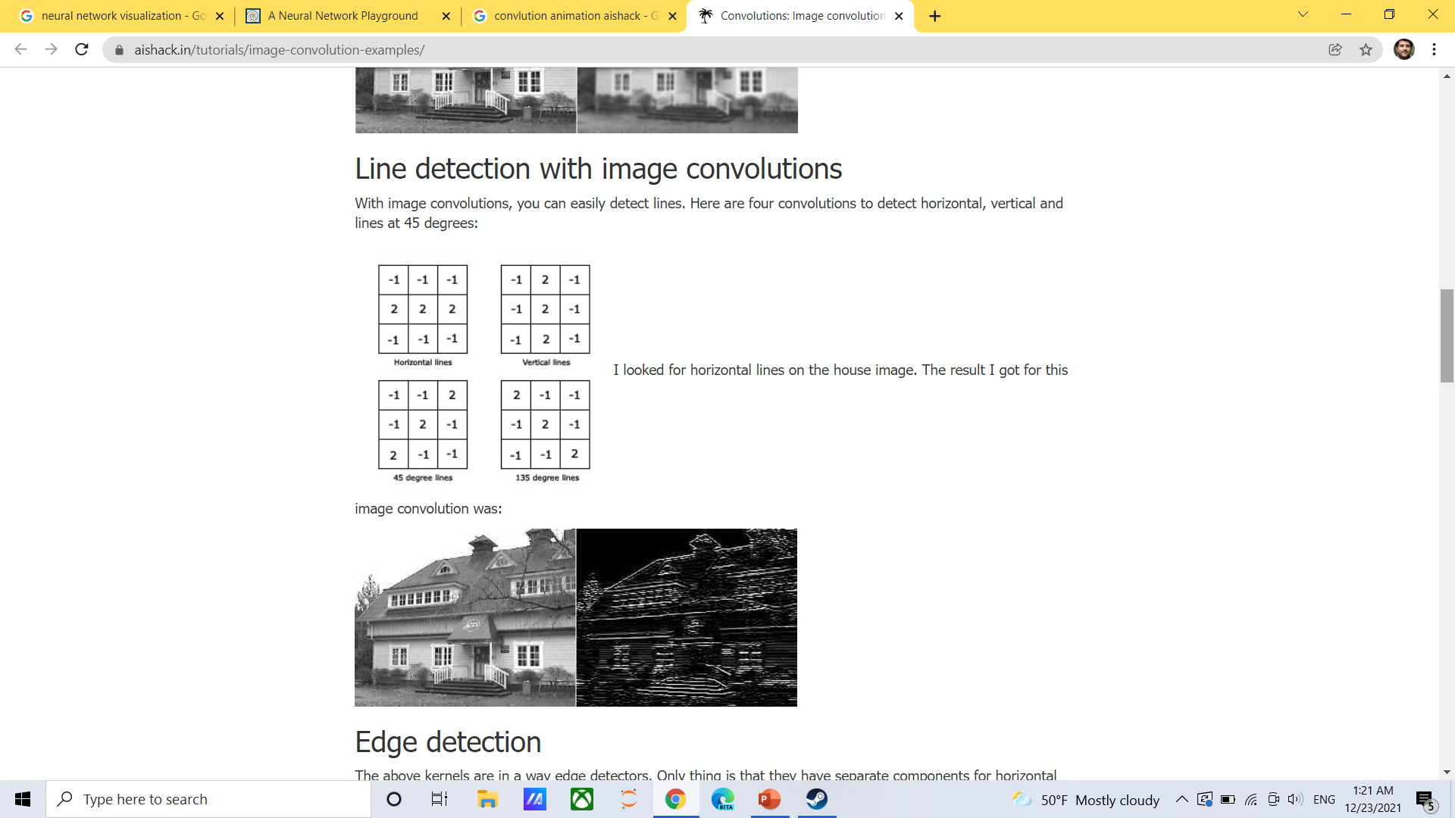
مروری بر برخی مکانیزم های استخراج ویژگی در تصویر
https://aishack.in/tutorials/image-convolution-examples/

Slide 9

مروری بر برخی مکانیزم های استخراج ویژگی در تصویر
https://aishack.in/tutorials/image-convolution-examples/

Slide 10
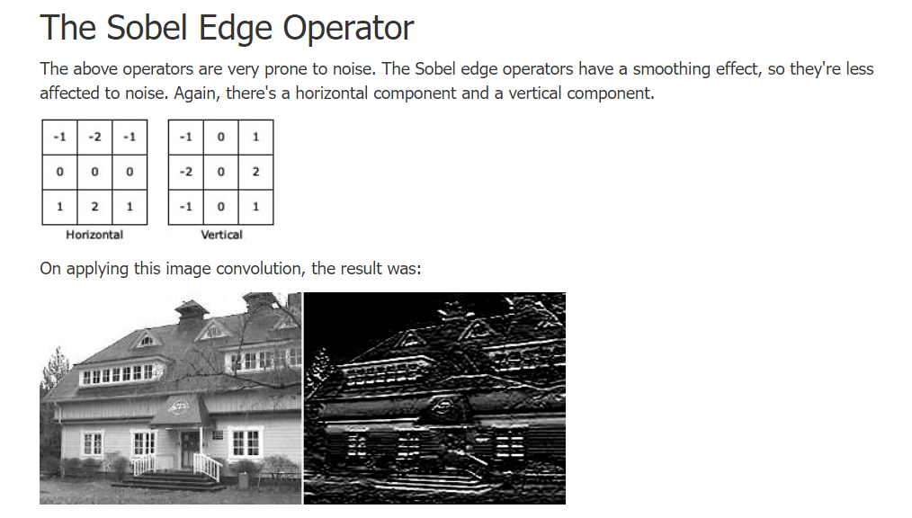
مروری بر برخی مکانیزم های استخراج ویژگی در تصویر
https://aishack.in/tutorials/image-convolution-examples/

Slide 11

مروری بر برخی مکانیزم های استخراج ویژگی در تصویر
https://aishack.in/tutorials/image-convolution-examples/

Slide 12

مروری بر برخی مکانیزم های استخراج ویژگی در تصویر
https://aishack.in/tutorials/image-convolution-examples/

Slide 13
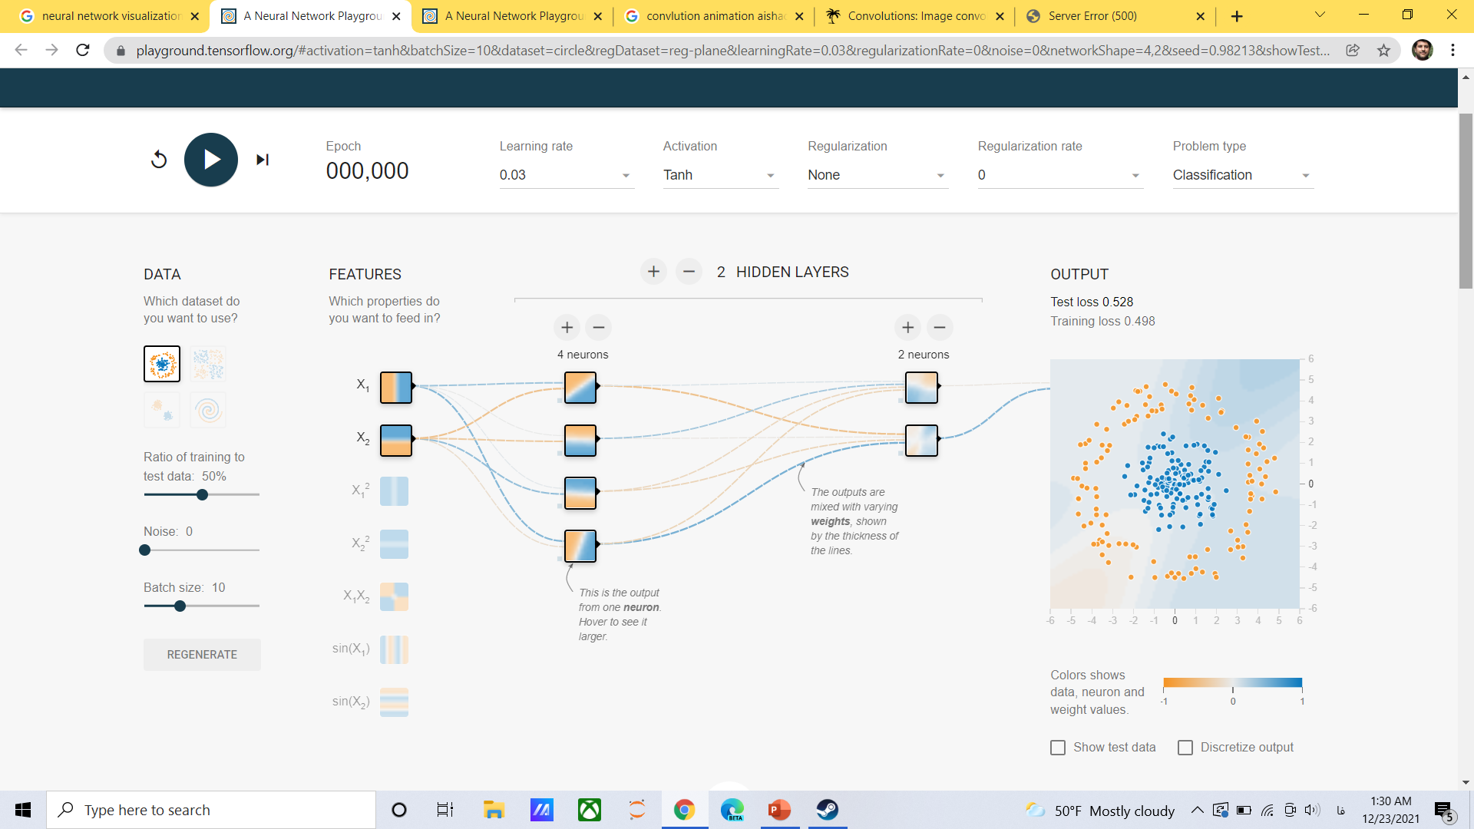
مروری بر عملکرد شبکه عصبی
https://playground.tensorflow.org/

Slide 14
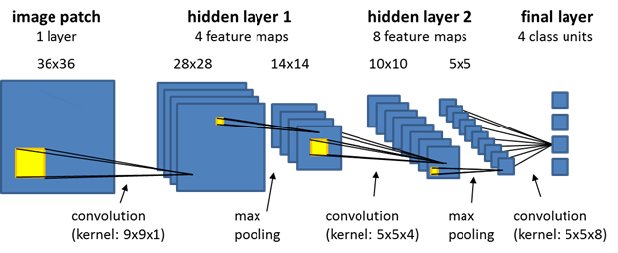
عملیات های کانولوشن و کاهش ابعاد

Slide 15
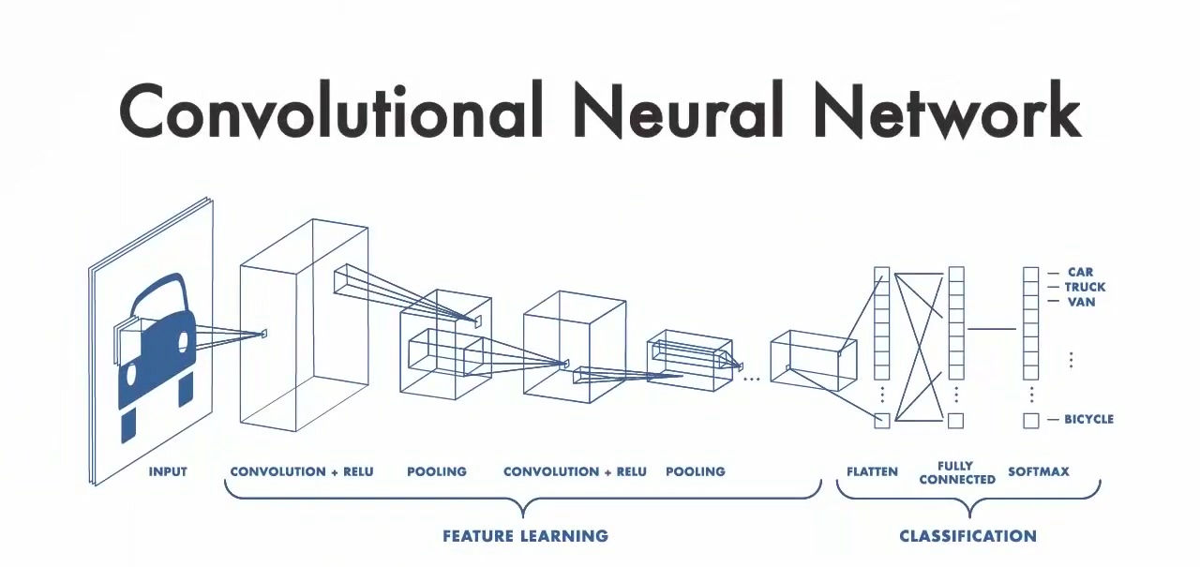
عملیات های کانولوشن و کاهش ابعاد

Slide 16

عملیات های کانولوشن و عمل پدینگ برای جلوگیری از کاهش ابعاد

Slide 17

عملیات های کانولوشن و پدینگ برای جلوگیری از کاهش ابعاد
بدون پدینگ ابعاد کاهش پیدا خواهد کرد
در این مثال
پدینگ داریم

Slide 18
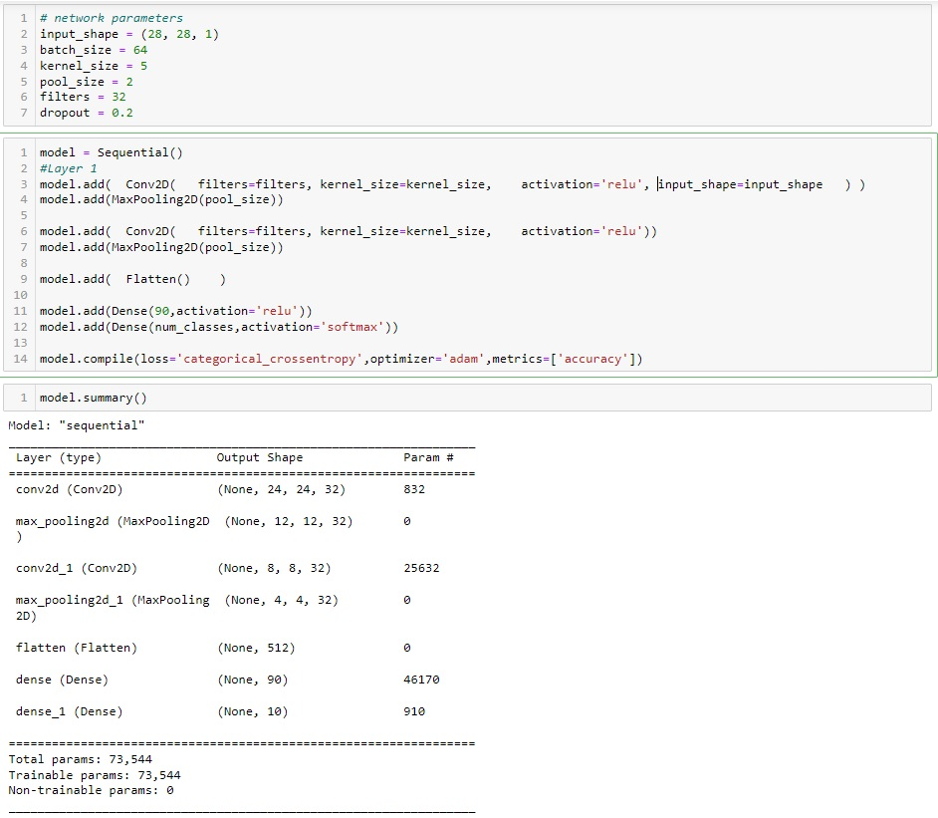
پارامترهای مدل
ابعاد تصویر بعد از اعمال 32 فیلتر کانولوشن
Param=7Filters * ((kernel_size * kernel_size)+1)
=32 * ((5*5) +1) =832
ابعاد تصویر بعد از اعمال مکس پولینگ نصف می شود
(832 – 31) * 32=25632
(512 +1) * 90=46170
کاهش ابعاد بواسطه اعمال کرنل
(90 +1) * 10=910

Slide 19
LSTM: Long Short-term memory
Ali Mollaei
1403/02/27

Slide 20
داده های ترتیبی
Sequential Data such as :
Speech recognition
Music generation
Sentiment classification
DNA sequence analysis
Video activity recognition
Name entity recognition
Translation
Crypto currency
…

Slide 21
داده های ترتیبی
داده های حال
به
داده های گذشته
وابسته هستند

Slide 22
داده های ترتیبی
داده های حال
از
داده های گذشته
تاثیرپذیرند

Slide 23
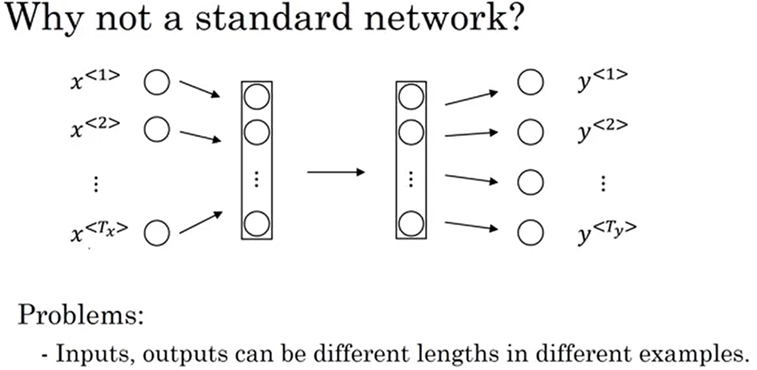
چرا شبکه های عصبی معمولی برای داده های ترتیبی دیگر کاربردی ندارند؟
دلایل عدم کارایی مدل های معمولی شبکه عصبی برای داده ترتیبی:
ورودی های با طول های مختلف وجود دارد که این شبکه ها برای درک دقیق ضعیف هستند.
عدم درک تاثیر ورودی های قبلی و قبلتر که در پیش بینی کلمه بعدی تاثیرگدارند.

Slide 24
داده های ترتیبی
در ورودی یک شبکه عصبی با n ورودی ممکن است طولی کمتر از n داشته باشد.
بنابراین باید عملی مانند Zero Padding انجام شود.

Slide 25
شبکه های عصبی بازگشتی (Recurrent Neural Networks)
شبکه های عصبی بازگشتی در سال ۱۹۸۰ ایجاد شدند
به طور ویژه در کاربردهای مختلف مرتبط با داده های سری استفاده می شود
در این شبکه حالت قبلی داده ها در پیش بینی حالت جدید اهمیت دارد
در شبکه های RNN حالت های قبلی مهم حفظ و نگهداری می شوند
یک خروجی در زمان t برای یک ورودی در زمان t-1 در نظر گرفته می شود.

Slide 26
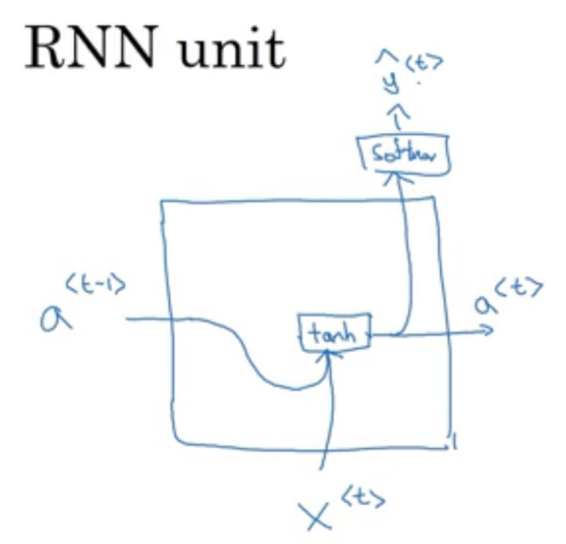
یک واحد RNN

Slide 27
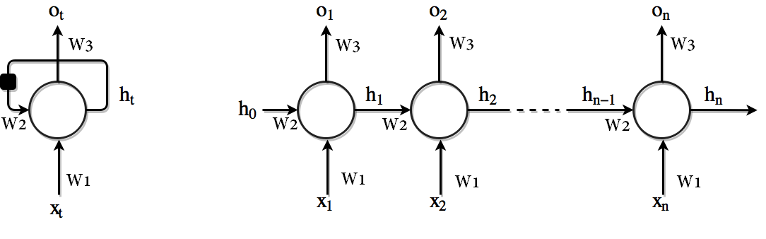
شبکه های عصبی بازگشتی (Recurrent Neural Networks)
هر نود یک زمان خاص
مربع سیاه نشانگر تاخیر زمانی
Unrolled
ورودی ها

Slide 28
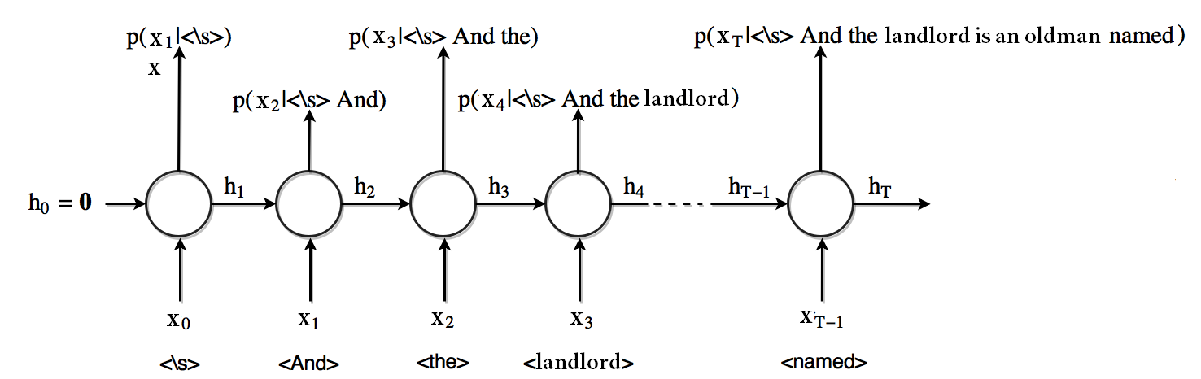
شبکه های عصبی بازگشتی (Recurrent Neural Networks)
در این مدل هدف پیش بینی احتمال کلمه بعدی به شرط ورودی که کلمات جاری و قبلی می باشد.

Slide 29
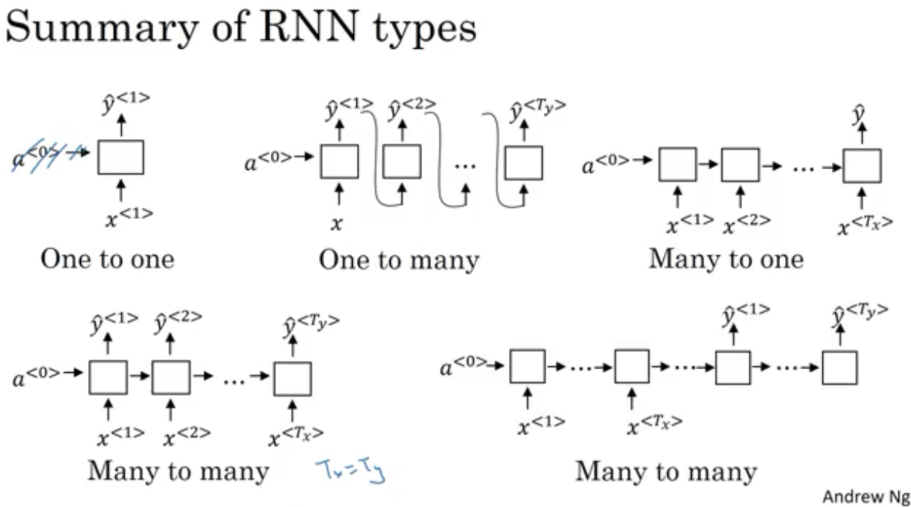

Slide 30
شبکه های عصبی بازگشتی (Recurrent Neural Networks)
شبکه های عصبی بازگشتی
در عمل
قادر به یادآوری
وابستگی های
بلند مدت
نیستند

Slide 31
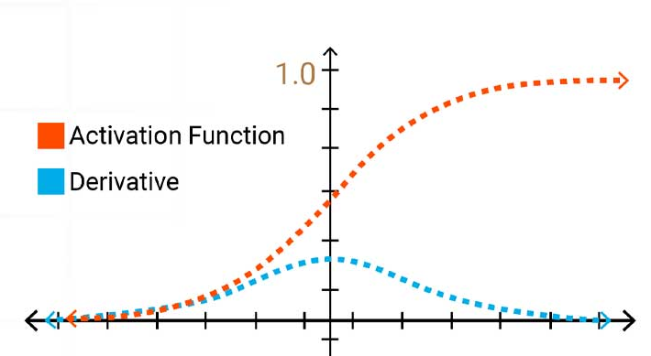
Vanishing gradiant
در طول انتشار پس‌انداز، گرادیان‌ها با حرکت به سمت عقب از لایه خروجی به سمت لایه‌های قبلی در شبکه، ضرب می‌شوند. اگر توابع فعال‌سازی مورد استفاده در شبکه دارای مقادیر کمتر از 1 (و به ویژه مقادیر نزدیک به 0) باشند، این ضرب‌ها می‌توانند باعث شوند که گرادیان‌ها تا زمانی که به لایه‌های قبلی برسند بسیار کوچک شوند یا حتی کاملاً از بین بروند. زمانی اتفاق می افتد که مشتق شبکه در مرحله بازگشت به عقب برابر صفر می شود.
توابع فعال‌سازی خاص، مانند سیگموئید، بیشتر مستعد ایجاد گرادیان‌های محو می‌شوند.
مشتق ها آنقدر کوچک هستند که محو شدگی گرادیان بوجود خواهد آمد.
استفاده از توابع فعال‌سازی است که به مشتق با مقدار کوچک را نتیجه ندهد؛ برای مثال، تابع ReLU جایگزین بسیار خوبی است.
Batch Normalization Layers
راه‌حل دوم استفاده از شبکه‌های باقیمانده (Residual networks) است. این شبکه‌ها مجموعه‌ای از اتصالات اضافی (Residual Connections) دارند که مستقیماً به لایه‌های اول وصل می‌شوند.
مقداردهی اولیه وزن ها
Weight Initialization: Initializing weights in a specific way, like using Xavier initialization or He initialization, can help ensure the gradients have a healthy starting range.
استفاده از معماری‌هایی مانند شبکه‌های حافظه طولانی کوتاه‌مدت LSTM

Slide 32
شبکه های عصبی بازگشتی (Recurrent Neural Networks)
vanishing gradient یا محو گرادیان :
به سمت صفر میل کردن مشتقات در عملیات پس انتشار
برای مقابله با مشکل vanishing gradient یکی از موثرترین راه ها استفاده از مقداردهی اولیه مناسب وزن هاست که یکی از معروف ترین الگوریتم ها برای این منظورالگوریتم مقداردهی اولیه Xavier است.
راه حل دیگری که بطور گسترده مورد استفاده قرار میگیرد استفاده از معماری LSTM است .
LSTM گونه دیگری از شبکه عصبی بازگشتی است که بطور ویژه بگونه ای طراحی شده است تا وابستگی های زمانی بلند مدت در دنباله ورودی را دریافت و حفظ کند.

Slide 33
which deep learning model are inherently prone to vanishing gradient?
While all deep neural networks can be susceptible to vanishing gradients to some extent, Recurrent Neural Networks (RNNs) are particularly prone to this problem.
Here's why RNNs are more vulnerable:
Sequential Nature: RNNs deal with sequential data where information from previous steps influences the current output. This creates a long chain of dependencies that gradients need to flow through during backpropagation.
Backpropagation Through Time: Training RNNs involves backpropagating the error signal through the entire sequence, one step at a time. With each step, the gradients get multiplied by the derivatives of the activation functions.
Activation Functions: Activation functions with values less than 1, especially those close to 0, can significantly shrink the gradients during backpropagation. In RNNs, these multiplications happen across many time steps, amplifying the vanishing effect.
Impact on RNNs:
Vanishing gradients in RNNs can severely limit their ability to learn long-term dependencies within the sequence. Since information from earlier time steps has weaker gradients, the network struggles to understand how they influence later elements. This becomes a hurdle in tasks like:
Language translation: Understanding the context of a sentence heavily relies on words from earlier parts.
Speech recognition: Recognizing a word depends on the sounds that came before it.
Time series forecasting: Predicting future values in a sequence requires considering historical data points.
Mitigating Vanishing Gradients in RNNs:
Several techniques can help address vanishing gradients in RNNs:
Activation Functions: Using activations like ReLU (Rectified Linear Unit) that avoid values close to 0.
Weight Initialization: Initializing weights in a specific way (e.g., Xavier or He initialization) helps gradients start in a healthy range.
Long Short-Term Memory (LSTM) Networks: LSTMs have built-in mechanisms to control the flow of information and mitigate vanishing gradients.
Gated Recurrent Units (GRUs): Similar to LSTMs, GRUs offer another architecture specifically designed to address vanishing gradients.
Conclusion:
While other deep learning models can experience vanishing gradients, the inherent sequential nature of RNNs makes them particularly susceptible. By understanding this relationship and using appropriate techniques, you can train RNNs more effectively to leverage long-term dependencies within your sequential data.
Notes:
edit
which deep learning model are inherently prone to vanishing gradient?
edit
Show drafts Draft 1 While all deep neural networks can be susceptible to vanishing gradients to some extent, Recurrent Neural Networks (RNNs) are particularly prone to this problem.
Here's why RNNs are more vulner...
Draft 1 While all deep neural networks can be susceptible to vanishing gradients to some extent, Recurrent Neural Networks (RNNs) are particularly prone to this problem.
Here's why RNNs are more vulnerable:
Sequential Nature: RNNs deal with sequential data where information from previous steps influences the current output. This creates a long chain of dependencies that gradients need to flow through during backpropagation.
Backpropagation Through Time: Training RNNs involves backpropagating the error signal through the entire sequence, one step at a time. With each step, the gradients get multiplied by the derivatives of the activation functions.
Activation Functions: Activation functions with values less than 1, especially those close to 0, can significantly shrink the gradients during backpropagation. In RNNs, these multiplications happen across many time steps, amplifying the vanishing effect.
Impact on RNNs:
Vanishing gradients in RNNs can severely limit their ability to learn long-term dependencies within the sequence. Since information from earlier time steps has weaker gradients, the network struggles to understand how they influence later elements. This becomes a hurdle in tasks like:
Language translation: Understanding the context of a sentence heavily relies on words from earlier parts.
Speech recognition: Recognizing a word depends on the sounds that came before it.
Time series forecasting: Predicting future values in a sequence requires considering historical data points.
Mitigating Vanishing Gradients in RNNs:
Several techniques can help address vanishing gradients in RNNs:
Activation Functions: Using activations like ReLU (Rectified Linear Unit) that avoid values close to 0.
Weight Initialization: Initializing weights in a specific way (e.g., Xavier or He initialization) helps gradients start in a healthy range.
Long Short-Term Memory (LSTM) Networks: LSTMs have built-in mechanisms to control the flow of information and mitigate vanishing gradients.
Gated Recurrent Units (GRUs): Similar to LSTMs, GRUs offer another architecture specifically designed to address vanishing gradients.
Conclusion:
While other deep learning models can experience vanishing gradients, the inherent sequential nature of RNNs makes them particularly susceptible. By understanding this relationship and using appropriate techniques, you can train RNNs more effectively to leverage long-term dependencies within your sequential data.
Draft 2 While all deep learning models using gradient descent can be susceptible to vanishing gradients to some extent, some architectures are inherently more prone to it than others. Here's the breakdown:
*...
Draft 2 While all deep learning models using gradient descent can be susceptible to vanishing gradients to some extent, some architectures are inherently more prone to it than others. Here's the breakdown:
Most Prone:
Recurrent Neural Networks (RNNs): As discussed earlier, RNNs are particularly susceptible due to the long chains of multiplications during backpropagation through sequential data. The gradients have to travel back through the entire sequence, making them more likely to vanish before reaching earlier layers.
Prone:
Deep Neural Networks (DNNs): DNNs with many layers can also experience vanishing gradients, especially if they use activation functions with derivatives less than 1 throughout the training range. The deeper the network, the more multiplications the gradients have to go through, increasing the chance of vanishing.
Less Prone:
Convolutional Neural Networks (CNNs): CNNs generally have a fixed-size receptive field, meaning each neuron only processes a local area of the input. This limits the number of multiplications gradients have to go through during backpropagation, making them less susceptible to vanishing compared to RNNs and very deep DNNs.
Additional Factors:
Activation Functions: Activation functions with derivatives close to 0 (like sigmoid in certain ranges) can significantly worsen the vanishing gradient problem in any model.
Network Depth: The deeper the network, the higher the risk of vanishing gradients, regardless of the architecture.
In essence, any deep learning model that relies on backpropagation and uses activation functions prone to small derivatives is at risk of vanishing gradients. However, RNNs stand out due to the inherent chain-like nature of processing sequential data, making them the most susceptible architecture.
Draft 3 While all deep learning models can be susceptible to vanishing gradients to some extent, Recurrent Neural Networks (RNNs) are particularly prone to this problem. Here's why:
**Sequential Natu...
Draft 3 While all deep learning models can be susceptible to vanishing gradients to some extent, Recurrent Neural Networks (RNNs) are particularly prone to this problem. Here's why:
Sequential Nature: RNNs are designed for sequential data, where the output at each step depends on the current input and the hidden state carrying information from previous steps. This creates a long chain of dependencies during backpropagation.
Long Backpropagation Chain: Backpropagation calculates gradients by iterating through the entire sequence. In RNNs, the gradients need to flow backwards through this entire chain, from the final output all the way back to the first input.
Multiplication of Gradients: During backpropagation, the gradients are multiplied at each step in the chain. If the activation functions used in the RNN have values less than 1 (especially close to 0), these multiplications can cause the gradients to become very small or vanish entirely by the time they reach the earlier layers.
Impact on RNNs:
Vanishing gradients in RNNs significantly hinder their ability to learn long-term dependencies in the data.
Information from earlier time steps has weaker gradients, making it difficult for the network to understand how these elements influence the later ones in the sequence.
Other Deep Learning Models:
While RNNs are the most susceptible, vanishing gradients can also occur in other deep learning models with many layers, especially if they use activation functions prone to small derivative values.
In Summary:
RNNs are inherently prone to vanishing gradients due to the long chains of multiplications during backpropagation through time steps.
However, any deep learning model with many layers and activation functions with values less than 1 can also experience vanishing gradients to some extent.
refresh Regenerate drafts
volume_up
While all deep neural networks can be susceptible to vanishing gradients to some extent, Recurrent Neural Networks (RNNs) are particularly prone to this problem.
Here's why RNNs are more vulnerable:
Sequential Nature: RNNs deal with sequential data where information from previous steps influences the current output. This creates a long chain of dependencies that gradients need to flow through during backpropagation.
Backpropagation Through Time: Training RNNs involves backpropagating the error signal through the entire sequence, one step at a time. With each step, the gradients get multiplied by the derivatives of the activation functions.
Activation Functions: Activation functions with values less than 1, especially those close to 0, can significantly shrink the gradients during backpropagation. In RNNs, these multiplications happen across many time steps, amplifying the vanishing effect.
Impact on RNNs:
Vanishing gradients in RNNs can severely limit their ability to learn long-term dependencies within the sequence. Since information from earlier time steps has weaker gradients, the network struggles to understand how they influence later elements. This becomes a hurdle in tasks like:
Language translation: Understanding the context of a sentence heavily relies on words from earlier parts.
Speech recognition: Recognizing a word depends on the sounds that came before it.
Time series forecasting: Predicting future values in a sequence requires considering historical data points.
Mitigating Vanishing Gradients in RNNs:
Several techniques can help address vanishing gradients in RNNs:
Activation Functions: Using activations like ReLU (Rectified Linear Unit) that avoid values close to 0.
Weight Initialization: Initializing weights in a specific way (e.g., Xavier or He initialization) helps gradients start in a healthy range.
Long Short-Term Memory (LSTM) Networks: LSTMs have built-in mechanisms to control the flow of information and mitigate vanishing gradients.
Gated Recurrent Units (GRUs): Similar to LSTMs, GRUs offer another architecture specifically designed to address vanishing gradients.
Conclusion:
While other deep learning models can experience vanishing gradients, the inherent sequential nature of RNNs makes them particularly susceptible. By understanding this relationship and using appropriate techniques, you can train RNNs more effectively to leverage long-term dependencies within your sequential data.

Slide 34
مقدمه ای بر LSTM
Long timesteps: it means how many past data you consider to predict future value
gating mechanism : LSTM use a gating mechanism that controls the memorizing process
Input gate : The input gate controls new information to flow into the cell state.
Forget gate : The forget gate removes previous unimportant information from the cell state.
Output gate : The output gate regulates extracted information from the cell state and then decides the next hidden state.

Slide 35
انواع LSTM
مدل های مختلفی از LSTM وجود دارد
LSTM
DLSTM
LSTMP
DLSTMP

Slide 36

LSTM

Slide 37
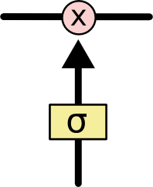
LSTM
Gates are a way to optionally let information through. They are composed out of a sigmoid neural net layer and a pointwise multiplication operation.
The sigmoid layer outputs numbers between zero and one, describing how much of each component should be let through.
A value of zero means “let nothing through,” while a value of one means “let everything through!”
An LSTM has three of these gates, to protect and control the cell state.

Slide 38
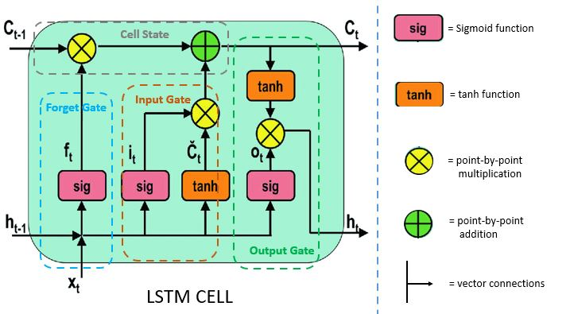
LSTM
ما فقط زمانی مقادیر جدید را به حالت وارد می کنیم که چیز قدیمی تر را فراموش کنیم.

Slide 39
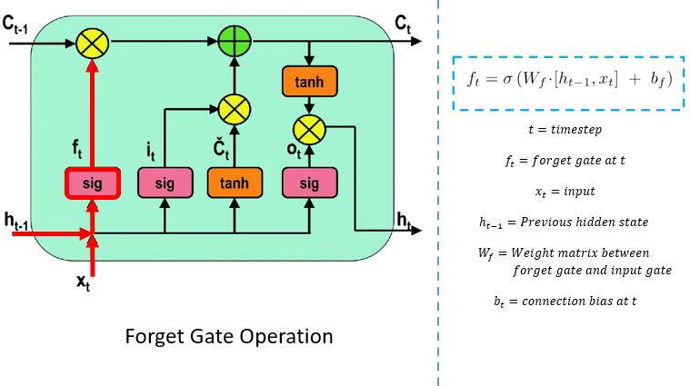
LSTM : forget gate
گیت فراموشی (forgot) تصمیم می گیرد که به کدام اطلاعات باید توجه (attention) شود. تابع سیگموئید با تولید عددی بین 0 و 1 تصمیم می گیرد که چه میزان از داده قدیمی لازم است.

Slide 40
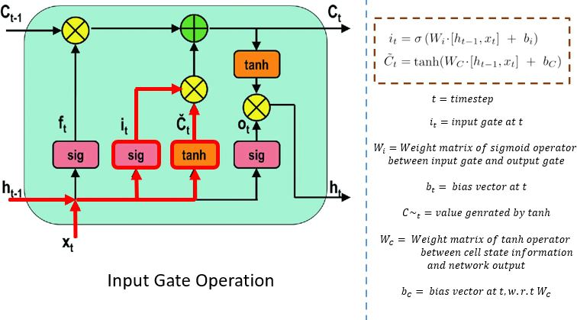
LSTM : input gate

Slide 41
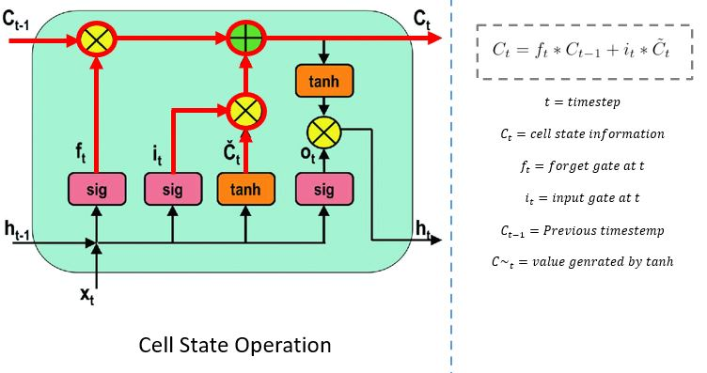
LSTM : cell state

Slide 42
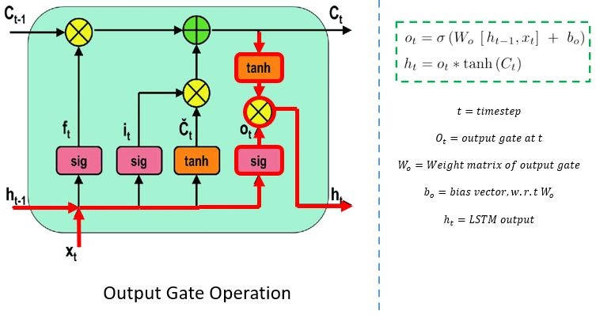
LSTM : output gate

Slide 43
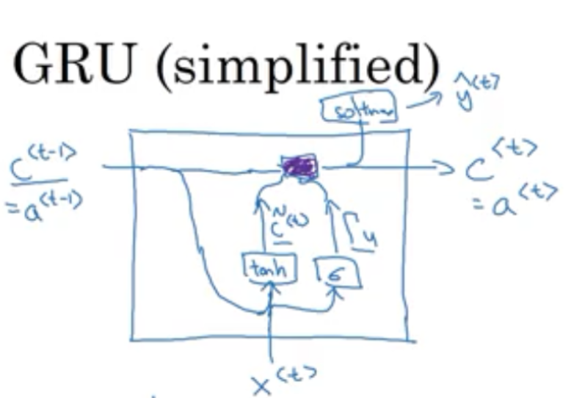
GRU

